Slide 1

Mystery Puzzle world
A Data Structures & Algorithms Based Puzzle Solving game
Developed By
BHOOMI (TCT-005) , HEER (TCT-026)
Course: CT-159 -Data Structure Algorithms and Applications
Instructor: Engr. Anees Ahmed
Thar institute of Engineering, Sciences & Technology
1

Slide 2

Introduction
Mystery Puzzle World is an interactive puzzle-solving application developed in Java Swing.
The project demonstrates practical use of Data Structures & Algorithms in a real-time game environment.
The system manages questions, evaluates answers, tracks attempts, and maintains a ranked leaderboard.
The game reinforces logical thinking, memory, and analytical skills.
Notes:
© Copyright Showeet.com – Free PowerPoint Templates

Slide 3
Problem Definition
Efficient storage & retrieval of multiple puzzle questions.
Managing puzzle levels and question flow systematically.
Tracking player performance, attempts, and score progression.
Displaying ranked leaderboard using sorted player records.
Maintaining a smooth user experience using optimized DSA
Notes:
© Copyright Showeet.com – Free PowerPoint Templates

Slide 4
Objective :
Implement a puzzle-solving system using core DSA concepts.
Ensure efficient question flow using Queue (FIFO).
Track player answers using Stack (LIFO).
Maintain level-wise attempts using HashMap.
Build leaderboard using sorting algorithms.
Present results through a clean and interactive GUI.

Slide 5
Importance of data structure in this game
Improves game performance & responsiveness.
Ensures efficient handling of large question sets.
Helps maintain order of execution (FIFO/LIFO).
Enables fair ranking using sorting.
Makes the system scalable and easy to maintain.
5

Slide 6
Data structure used
Data Structure | Where Used | Purpose
HashMap | QuestionBank, levelAttempts | Level → questions / track attempts
ArrayList | Questions, leaderboard | Dynamic list of questions and players
Queue (LinkedList) | GameEngine | FIFO question delivery
Stack | GameEngine | LIFO answer tracking for review
Array | Question options | Store 4 choices for each question

Slide 7
Algorithms used
FIFO Queue Algorithm → Retrieve next question.
LIFO Stack Algorithm → Track last given answers.
Sorting Algorithm → Rank players by total attempts.
Level Progression Logic → Check correctness for level-up.
File Read/Write → Save & load leaderboard
6

Slide 8
Research Context
Puzzles enhance computational and logical thinking
Widely used in AI search problems (Maze, Sudoku, BFS, DFS)
Efficiency heavily depends on data structure selection
Real-world domains: cybersecurity, robotics, game development, pathfinding better slide title
Notes:
© Copyright Showeet.com – Free PowerPoint Templates

Slide 9
System Design / flow diagram
Start
Enter Name
Load Level
Queue Questions
Answer
Push to Stack
Score Calculation
LeaderBoard
End
Correct

Slide 10
System Architecture
UI Layer → Takes user input
Logic Layer → Validates puzzle
Data Structure Layer → Stores puzzles
Output Layer → Shows result

Slide 11
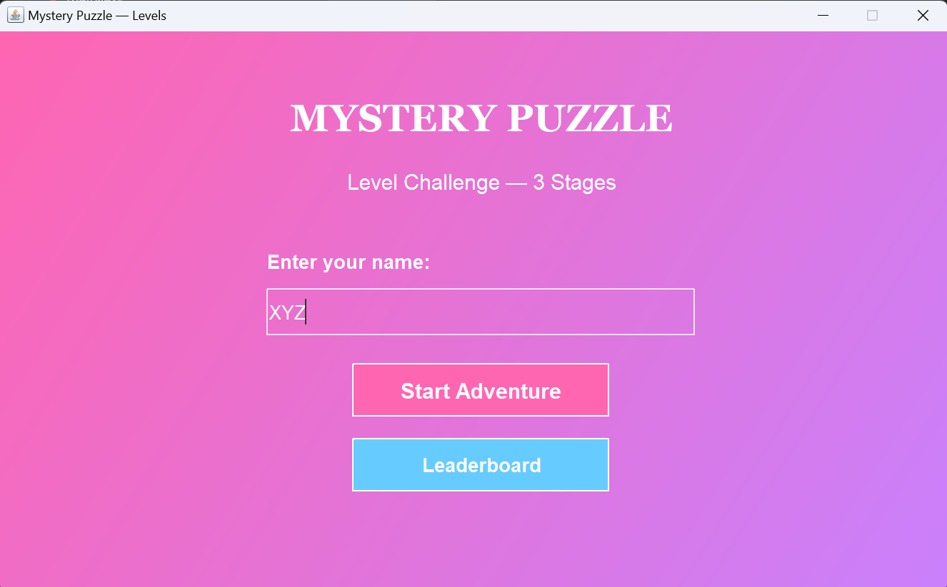
Implementation
WELCOME SCREEN

Slide 12
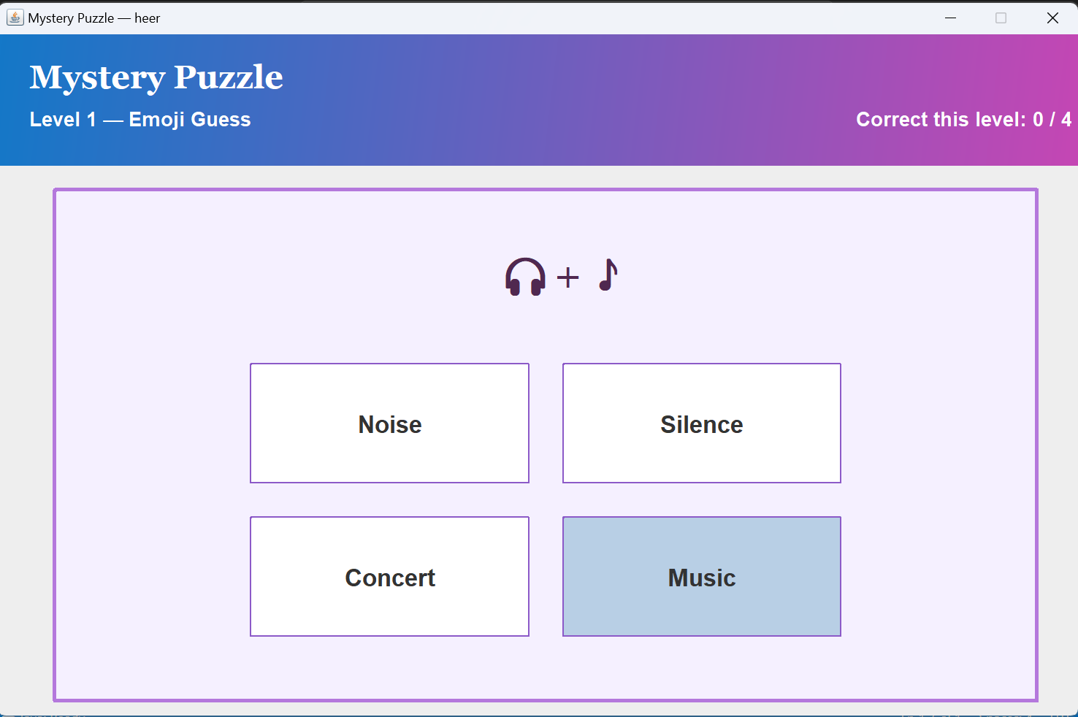
Puzzle screen
12

Slide 13
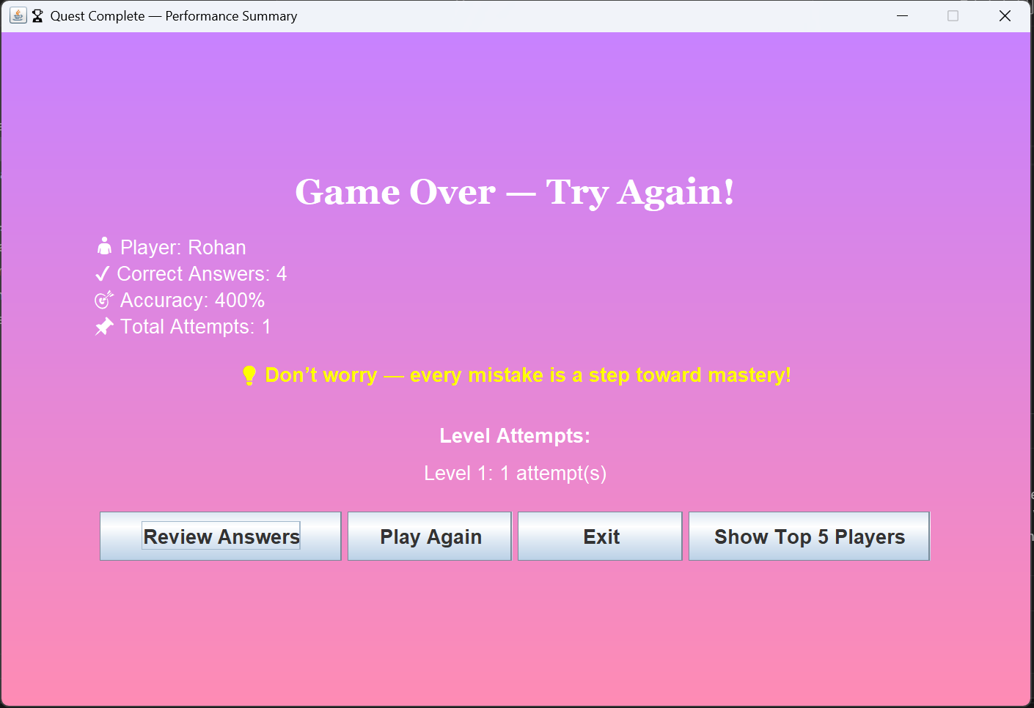
Result screen
13

Slide 14
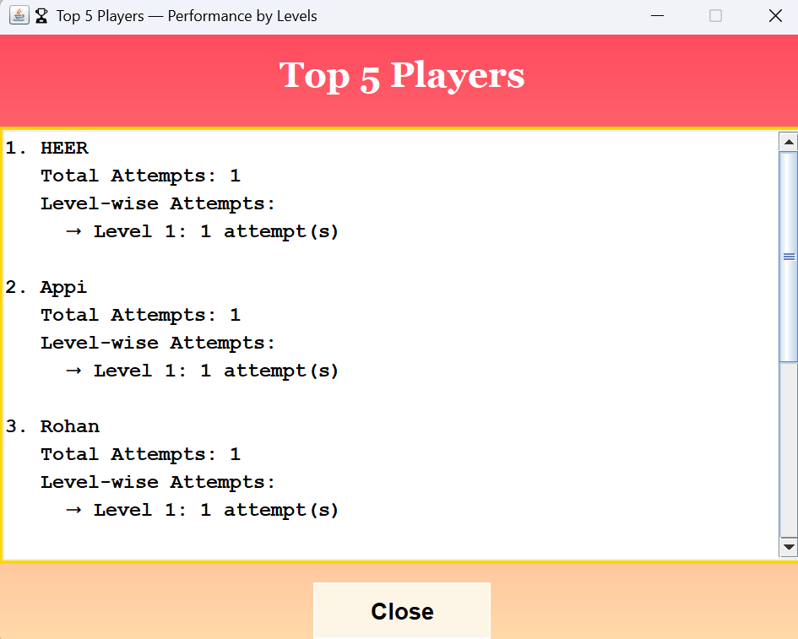
Leaderboard screen
14

Slide 15

applications
Limitations
Educational tools
Cognitive training apps
Game development
AI reasoning systems
Brain training apps
Competitive programming practice
Limited puzzle sets (unless expanded).
GUI depends on JavaFX layout responsiveness.
No online multiplayer mode.
No database integration (unless added).

Slide 16
Large Image slide
CONCLUSION
Successfully implemented key Data Structures & Algorithms.
Demonstrates real-world usage of Queue, Stack, HashMap, and Sorting.
Provides an interactive and educational puzzle-solving experience.
Enhances logical thinking and analytical skills.
Can be further expanded into a full educational game platform.
16
Notes:
© Copyright Showeet.com – Free PowerPoint Templates

Slide 17
THANK YOU

